Slide 1
Software Quality Assurance
Tasniya Ahmed
Lecturer
IIT,NSTU

Slide 2
What is Quality Assurance?
Quality Assurance is defined as the auditing and reporting procedures used to provide the stakeholders with data needed to make well-informed decisions.
It is the Degree to which a system meets specified requirements and customer expectations. It is also monitoring the processes and products throughout the SDLC.

Slide 3
Quality Assurance Criteria:
Below are the Quality assurance criteria against which the software would be evaluated against:
correctness
efficiency
flexibility
integrity
interoperability
maintainability
portability
reliability
reusability
testability
usability

Slide 4
What is Quality Control?
Quality control is a set of methods used by organizations to achieve quality parameters or quality goals and continually improve the organization's ability to ensure that a software product will meet quality goals.

Slide 5
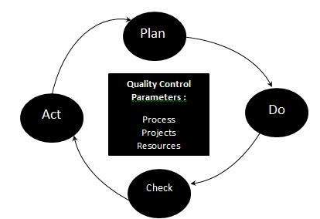
Quality Control Process:

Slide 6
Continue..
The three class parameters that control software quality are:
Products
Processes
Resources
The total quality control process consists of:
Plan - It is the stage where the Quality control processes are planned
Do - Use a defined parameter to develop the quality
Check - Stage to verify if the quality of the parameters are met
Act - Take corrective action if needed and repeat the work

Slide 7
Quality Control characteristics:
Process adopted to deliver a quality product to the clients at best cost.
Goal is to learn from other organizations so that quality would be better each time.
To avoid making errors by proper planning and execution with correct review process.

Slide 8
What is Software Quality Management?
Software Quality Management ensures that the required level of quality is achieved by submitting improvements to the product development process. SQA aims to develop a culture within the team and it is seen as everyone's responsibility.
Software Quality management should be independent of project management to ensure independence of cost and schedule adherences. It directly affects the process quality and indirectly affects the product quality.

Slide 9
Activities of Software Quality Management:
Quality Assurance - QA aims at developing Organizational procedures and standards for quality at Organizational level.
Quality Planning - Select applicable procedures and standards for a particular project and modify as required to develop a quality plan.
Quality Control - Ensure that best practices and standards are followed by the software development team to produce quality products.

Slide 10
Software Quality Assurance (SQA)
Software Quality Assurance (SQA) is a set of activities for ensuring quality in software engineering processes. It ensures that developed software meets and complies with the defined or standardized quality specifications. SQA is an ongoing process within the Software Development Life Cycle (SDLC) that routinely checks the developed software to ensure it meets the desired quality measures.
SQA practices are implemented in most types of software development, regardless of the underlying software development model being used. SQA incorporates and implements software testing methodologies to test the software. Rather than checking for quality after completion, SQA processes test for quality in each phase of development, until the software is complete. With SQA, the software development process moves into the next phase only once the current/previous phase complies with the required quality standards. SQA generally works on one or more industry standards that help in building software quality guidelines and implementation strategies.

Slide 11
It includes the following activities −
Process definition and implementation
Auditing
Training
Processes could be −
Software Development Methodology
Project Management
Configuration Management
Requirements Development/Management
Estimation
Software Design
Testing, etc.
Once the processes have been defined and implemented, Quality Assurance has the following responsibilities
Identify the weaknesses in the processes
Correct those weaknesses to continually improve the process

Slide 12
Components of SQA System
An SQA system always combines a wide range of SQA components. These components can be classified into the following six classes −
Pre-project components
This assures that the project commitments have been clearly defined considering the resources required, the schedule and budget; and the development and quality plans have been correctly determined.
Components of project life cycle activities assessment
The project life cycle is composed of two stages: the development life cycle stage and the operation–maintenance stage.
The development life cycle stage components detect design and programming errors. Its components are divided into the following sub-classes: Reviews, Expert opinions, and Software testing.
The SQA components used during the operation–maintenance phase include specialized maintenance components as well as development life cycle components, which are applied mainly for functionality to improve the maintenance tasks.

Slide 13
Continue..
Components of infrastructure error prevention and improvement
The main objective of these components, which is applied throughout the entire organization, is to eliminate or at least reduce the rate of errors, based on the organization’s accumulated SQA experience.
Components of software quality management
This class of components deal with several goals, such as the control of development and maintenance activities, and the introduction of early managerial support actions that mainly prevent or minimize schedule and budget failures and their outcomes.

Slide 14
Continue…
Components of standardization, certification, and SQA system assessment
These components implement international professional and managerial standards within the organization. The main objectives of this class are utilization of international professional knowledge, improvement of coordination of the organizational quality systems with other organizations, and assessment of the achievements of quality systems according to a common scale. The various standards may be classified into two main groups: quality management standards and project process standards.
Organizing for SQA – the human components
The SQA organizational base includes managers, testing personnel, the SQA unit and the persons interested in software quality such as SQA trustees, SQA committee members, and SQA forum members. Their main objectives are to initiate and support the implementation of SQA components, detect deviations from SQA procedures and methodology, and suggest improvements.

Slide 15
Pre-project Software Quality Components
These components help to improve the preliminary steps taken before starting a project. It includes −
Contract Review
Development and Quality Plans

Slide 16
Contract Review
Normally, a software is developed for a contract negotiated with a customer or for an internal order to develop a firmware to be embedded within a hardware product. In all these cases, the development unit is committed to an agreed-upon functional specification, budget and schedule. Hence, contract review activities must include a detailed examination of the project proposal draft and the contract drafts.
Specifically, contract review activities include −
Clarification of the customer’s requirements
Review of the project’s schedule and resource requirement estimates
Evaluation of the professional staff’s capacity to carry out the proposed project
Evaluation of the customer’s capacity to fulfil his obligations
Evaluation of development risks

Slide 17
Development and Quality Plans
After signing the software development contract with an organization or an internal department of the same organization, a development plan of the project and its integrated quality assurance activities are prepared. These plans include additional details and needed revisions based on prior plans that provided the basis for the current proposal and contract.
Most of the time, it takes several months between the tender submission and the signing of the contract. During these period, resources such as staff availability, professional capabilities may get changed. The plans are then revised to reflect the changes that occurred in the interim.
The main issues treated in the project development plan are −
Schedules
Required manpower and hardware resources
Risk evaluations
Organizational issues: team members, subcontractors and partnerships
Project methodology, development tools, etc.
Software reuse plans

Slide 18
The main issues treated in the project’s quality plan are −
Quality goals, expressed in the appropriate measurable terms
Criteria for starting and ending each project stage
Lists of reviews, tests, and other scheduled verification and validation activities

Slide 19
Software metrics
A software metric is a measure of software characteristics that are quantifiable or countable. Software metrics are important for many reasons, including measuring software performance, planning work items, measuring productivity, and many other uses.
Software metrics can be classified into three categories −
Product metrics − Describes the characteristics of the product such as size, complexity, design features, performance, and quality level.
Process metrics − These characteristics can be used to improve the development and maintenance activities of the software.
Project metrics − This metrics describe the project characteristics and execution. Examples include the number of software developers, the staffing pattern over the life cycle of the software, cost, schedule, and productivity.
Some metrics belong to multiple categories. For example, the in-process quality metrics of a project are both process metrics and project metrics.

Slide 20
Software quality metrics
Software quality metrics are a subset of software metrics that focus on the quality aspects of the product, process, and project. These are more closely associated with process and product metrics than with project metrics.
Software quality metrics can be further divided into three categories
Product quality metrics
In-process quality metrics
Maintenance quality metrics

Slide 21
Product Quality Metrics
This metrics include the following −
Mean Time to Failure
Defect Density
Customer Problems
Customer Satisfaction

Slide 22
Mean Time to Failure
It is the time between failures. This metric is mostly used with safety critical systems such as the airline traffic control systems.
Defect Density
It measures the defects relative to the software size expressed as lines of code or function point, etc. i.e., it measures code quality per unit. This metric is used in many commercial software systems.

Slide 23
Customer Problems
It measures the problems that customers encounter when using the product. It contains the customer’s perspective towards the problem space of the software, which includes the non-defect oriented problems together with the defect problems.
The problems metric is usually expressed in terms of Problems per User-Month (PUM).
PUM is usually calculated for each month after the software is released to the market, and also for monthly averages by year.

Slide 24
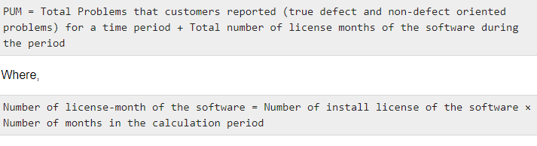

Slide 25
Customer Satisfaction
Customer satisfaction is often measured by customer survey data through the five-point scale −
Very satisfied
Satisfied
Neutral
Dissatisfied
Very dissatisfied
Satisfaction with the overall quality of the product and its specific dimensions is usually obtained through various methods of customer surveys. Based on the five-point-scale data, several metrics with slight variations can be constructed and used, depending on the purpose of analysis. For example −
Percent of completely satisfied customers
Percent of satisfied customers
Percent of dis-satisfied customers
Percent of non-satisfied customers
Usually, this percent satisfaction is used.

Slide 26
In-process Quality Metrics
In-process quality metrics deals with the tracking of defect arrival during formal machine testing for some organizations. This metric includes −
Defect density during machine testing
Defect arrival pattern during machine testing
Phase-based defect removal pattern
Defect removal effectiveness

Slide 27
Defect density during machine testing
Defect rate during formal machine testing (testing after code is integrated into the system library) is correlated with the defect rate in the field. Higher defect rates found during testing is an indicator that the software has experienced higher error injection during its development process, unless the higher testing defect rate is due to an extraordinary testing effort.

Slide 28
Defect arrival pattern during machine testing
The overall defect density during testing will provide only the summary of the defects. The pattern of defect arrivals gives more information about different quality levels in the field. It includes the following −
The defect arrivals or defects reported during the testing phase by time interval (e.g., week). Here all of which will not be valid defects.
The pattern of valid defect arrivals when problem determination is done on the reported problems. This is the true defect pattern.
The pattern of defect backlog overtime. This metric is needed because development organizations cannot investigate and fix all the reported problems immediately. This is a workload statement as well as a quality statement. If the defect backlog is large at the end of the development cycle and a lot of fixes have yet to be integrated into the system, the stability of the system (hence its quality) will be affected. Retesting (regression test) is needed to ensure that targeted product quality levels are reached.

Slide 29
Phase-based defect removal pattern
This is an extension of the defect density metric during testing. In addition to testing, it tracks the defects at all phases of the development cycle, including the design reviews, code inspections, and formal verifications before testing.
Because a large percentage of programming defects is related to design problems, conducting formal reviews, or functional verifications to enhance the defect removal capability of the process at the front-end reduces error in the software. The pattern of phase-based defect removal reflects the overall defect removal ability of the development process.
With regard to the metrics for the design and coding phases, in addition to defect rates, many development organizations use metrics such as inspection coverage and inspection effort for in-process quality management.

Slide 30
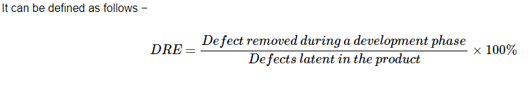
Defect removal effectiveness
This metric can be calculated for the entire development process, for the front-end before code integration and for each phase. It is called early defect removal when used for the front-end and phase effectiveness for specific phases. The higher the value of the metric, the more effective the development process and the fewer the defects passed to the next phase or to the field. This metric is a key concept of the defect removal model for software development.
a latent defect is a fault in the property that could not have been discovered by a reasonably thorough inspection before the sale.

Slide 31
Maintenance Quality Metrics
Although much cannot be done to alter the quality of the product during this phase, following are the fixes that can be carried out to eliminate the defects as soon as possible with excellent fix quality.
Fix backlog and backlog management index
Fix response time and fix responsiveness
Percent delinquent fixes
Fix quality

Slide 32

Fix backlog and backlog management index
Fix backlog is related to the rate of defect arrivals and the rate at which fixes for reported problems become available. It is a simple count of reported problems that remain at the end of each month or each week. Using it in the format of a trend chart, this metric can provide meaningful information for managing the maintenance process.
Backlog Management Index (BMI) is used to manage the backlog of open and unresolved problems.
If BMI is larger than 100, it means the backlog is reduced. If BMI is less than 100, then the backlog increased.

Slide 33
Fix response time and fix responsiveness
The fix response time metric is usually calculated as the mean time of all problems from open to close. Short fix response time leads to customer satisfaction.
The important elements of fix responsiveness are customer expectations, the agreed-to fix time, and the ability to meet one's commitment to the customer.

Slide 34
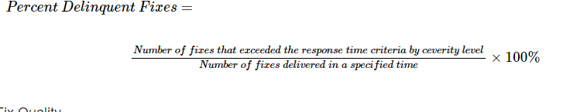
Percent delinquent fixes
It is calculated as follows −

Slide 35
Fix Quality
Fix quality or the number of defective fixes is another important quality metric for the maintenance phase. A fix is defective if it did not fix the reported problem, or if it fixed the original problem but injected a new defect. For mission-critical software, defective fixes are detrimental to customer satisfaction. The metric of percent defective fixes is the percentage of all fixes in a time interval that is defective.
A defective fix can be recorded in two ways: Record it in the month it was discovered or record it in the month the fix was delivered. The first is a customer measure; the second is a process measure. The difference between the two dates is the latent period of the defective fix.
Usually the longer the latency, the more will be the customers that get affected. If the number of defects is large, then the small value of the percentage metric will show an optimistic picture. The quality goal for the maintenance process, of course, is zero defective fixes without delinquency.

